Slide 1

JOB DESCRIPTION RECOMMENDATION USING NLP
RP-NVIDIA JAIIT PROJECT BRIEF

Slide 2


X0PA is an AI powered
end-to-end B2B platform
that helps in streamlining hiring and selections, from sourcing potential candidates, screening objectively and at scale, virtual and asynchronous interviews / assessments and final selections and onboarding.
x0pa.com

Slide 3



X0PA Products & Solutions
Use Cases
AI Candidate Sourcing
AI Pre-Screening
AI Talent Retargeting
Recruitment Process Outsourcing
Use Cases
Automated Video Interviews
Automated Assessments
Virtual Career Fairs
Use Cases
Graduate Hiring
Admission Management
Internship Management
x0pa.com

Slide 4

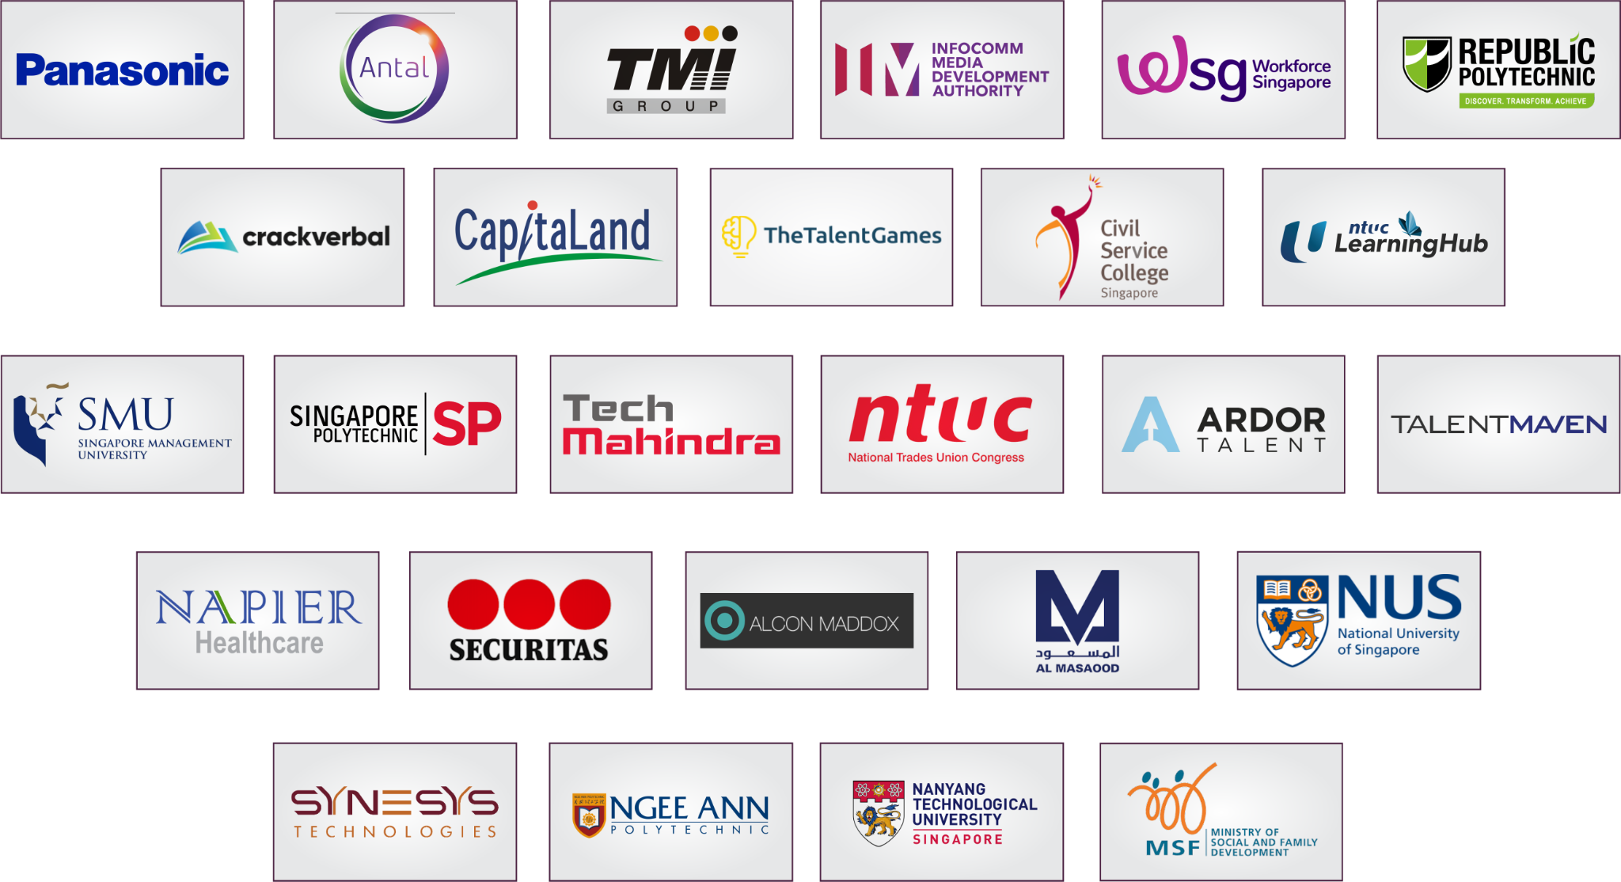
The most
forward
Thinking organisations use X0PA AI
Clients across: Singapore, India, The UAE, The Philippines, Indonesia, The UK
x0pa.com

Slide 5
Problem Statement
Companies usually struggle to come up with a Job Description (JD) that accurately describes the role and attract the right candidates. This is especially true for new roles where companies usually copy JDs posted by other companies. Recruiters may also not know what the qualifications and skills are required for the role and under/over-specify the requirements.
As a B2B SaaS provider in the recruitment space, X0PA aims to develop in-built capabilities to recommend JDs to recruiters based on information on the job/role provided. This would help companies to describe their job openings more accurately and attract the right candidates to the job.

Slide 6
Objectives
Develop a recommendation system that takes in at least job title and skills and outputs a job description.
Users of the JD recommender will be recruiters. The final feature will be integrated into X0PA’s AI Recruiter platform where recruiters can create job postings with ease.
Example:
Recruiter keys in job title “Frontend Developer” and enter skills “Javascript” and “CSS”.
Frontend Developer Responsibilities:
Determining the structure and design of web pages.
Ensuring user experience determines design choices.
Developing features to enhance the user experience.
Striking a balance between functional and aesthetic design.
Frontend Developer Requirements:
Understanding of key design principles.
Proficiency in HTML, CSS, JavaScript, and jQuery.
Understanding of server-side CSS.

Slide 7
Scope
The Project can have varying difficulty, recommended to start with a simple solution and gradually increase in complexity only if it improves performance.
Level 1: Rules-based recommender
Have a JD template for each Job Title
Label each role or requirements by skills / Fill-in-the-blanks methods
Show relevant role or requirement when skill is input by recruiter
Level 2: Multi-Class Classifier
Have a JD template for each Job Title
Label each role or requirements by skills using a supervised learning model
Show relevant role or requirement when skill is input by recruiter

Slide 8
Scope
Level 3: Multi-Class Classifier, Multiple Features
Have a JD template for each Job Title
Label each role or requirements by skills using a supervised learning model
Recruiters can provide other inputs such as work experience, education, industry, job level etc.
Level 4: Generative Model
Model able to generate JD without using a template / hybrid
Text generated will be based on user inputs such as Job Title, Industry, Job Level, Skills etc.
You are encouraged to try at least Level 2 for ML and NLP-related experience.

Slide 9
JD Components
Company Profile (Not required)
Summary (Good to have)
Roles & Responsibilities / Tasks (Compulsory)
Requirements (Compulsory)
Skills
Experience
Education
Others (Not required)

Slide 10
Deliverables
This is a Proof-of-Concept Project:
Reproducible code
Able to generate JD / predictions based on unseen /new data provided
Able to run in real-time
No UI required
Specify evaluation metrics to objectively evaluate the performance of the different solutions
Deliverables
Codes (training & inference codes)
Experiment tracking worksheet
Brief Report / Presentation Deck

Slide 11
Technical Stack
No OS requirement for Proof-of-Concept, however LINUX is preferred.
Any deep-learning framework can be used for DL components (Tensorflow/pytorch etc.)
(Preferred) All codes to be stored in a private Github repository for version control and easy collaboration.
(Preferred) All codes to be coded in Python 3.8 or above
PostgreSQL for Relational Data Storage (Excel / csv / txt acceptable for static data)
Virtual environment is a must. Container are also acceptable.

Slide 12
Data
X0PA will provide a sample datasets of JDs, data will be shared separately.
Data is confidential, please do not share or use outside of this project.
You are free to collect and use data from other sources as well (e.g. Jobstreet / LinkedIn / SkillsFramework etc.)
As a start (Level 1), can leverage on the Job Description Templates from LinkedIn and/or SkillsFramework.
Some manual labelling efforts maybe required for the project. Currently all data are unlabeled. Amazon Mechanical Turk (crowdsourcing data labelling) can be employed if justifiable.
Inform company representative for any other data required.

Slide 13
Company Representative
Lee Gang, Head of Data Science
leegang@x0pa.com (Official and formal correspondences)
Whatsapp: +65 9297 8647 (Whatsapp Group)

